Slide 1
LinkedIn Edunet
[Hospital Patients Records Cleaning & Health Metrics Dashboard]
P R E S E N T A T I O N 2 0 2 6
👤
Student Name
✉
Student Email
[Tithi Katyal]
[tithikatyal4@gmail.com]
📖
[Ankit]

Slide 2
edunet
foundation
OUTLINE
• Abstract of the Project
• Problem Statement
• Proposed Solution
• System Architecture
• Live Demo of the Project
• Embedded Video of Project
• Conclusion
• Future Scope

Slide 3
edunet
foundation
Abstract
• Using excel and copilot the data set is cleaned and validated an d transformed . A dashboard is created .
• This project focuses on cleaning and analyzing hospital patient records to generate meaningful health insights and predict heart attack in patients
• Created visual key metrics such as patient count , length of stay and treatment outcomes .
• Summarize The project demonstrates how data analytics can improve healthcare reporting and support better operational descion.
.

Slide 4
edunet
foundation
Problem Statement
• Hospitals handle large amounts of patient data that are often incomplete, inconsistent, and unstructured.
Because of this:
It is difficult to track patient flow and treatment outcomes
Key health metrics are not easily visible
No centralized dashboard exists for monitoring
This leads to poor decision-making and inefficiency in hospital operations.
.
.

Slide 5
edunet
foundation
Proposed Solution
To solve this problem:
Clean and validate patient data
Standardize medical categories
Create calculated fields like length of stay
Use Excel to build an interactive dashboard
Use Copilot to generate insights and summaries
This solution improves data accuracy and helps hospitals monitor patient trends effectively.

Slide 6
edunet
foundation
System Architecture
Data Input / Source
Processing / Analysis
[Patient dataset (CSV / Excel from Kaggle)]
[Data cleaning (remove duplicates, fix missing values)
Data transformation (create new columns) ]
AI / Tool Integration
Output / Dashboard
[Use excel with Copilot for insights and summaries
.]
[Excel dashboard with charts and KPIs]

Slide 7
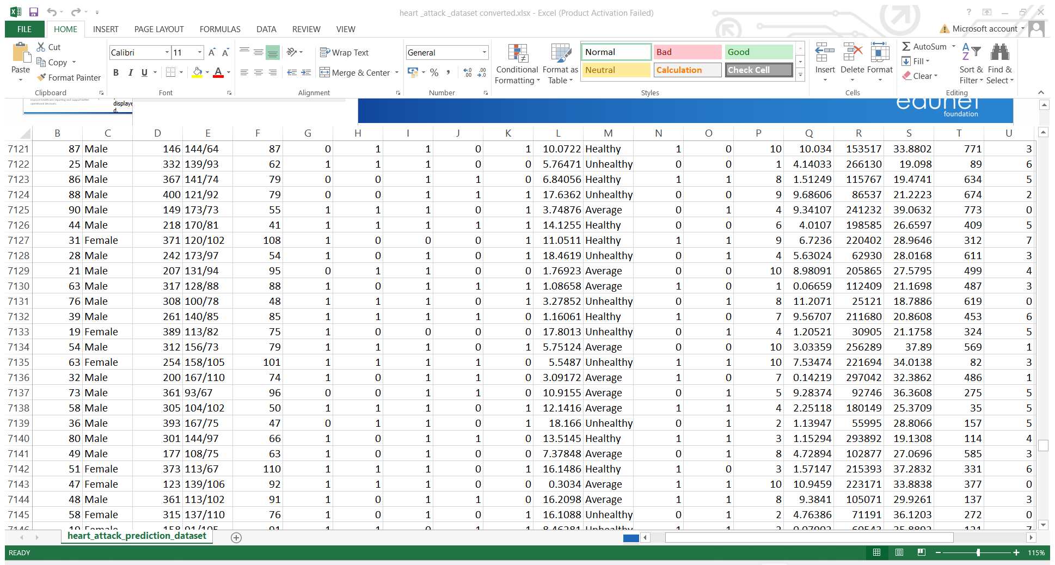
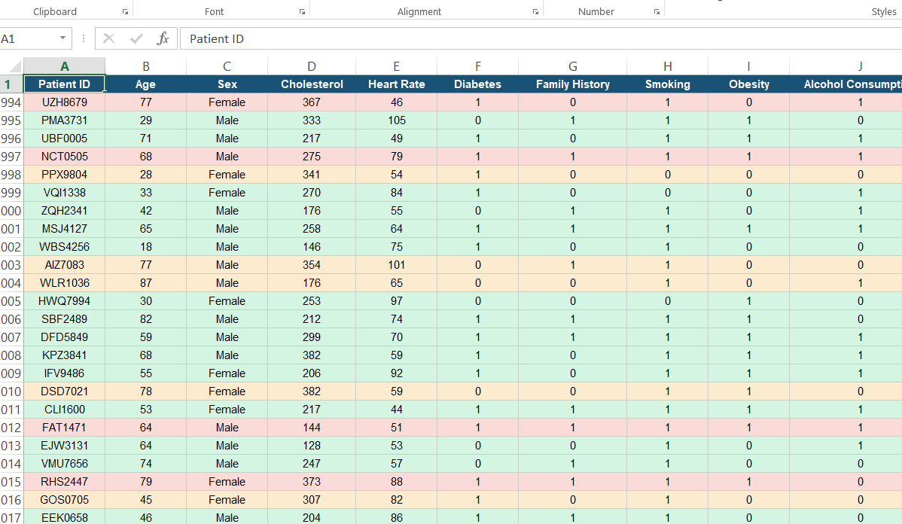
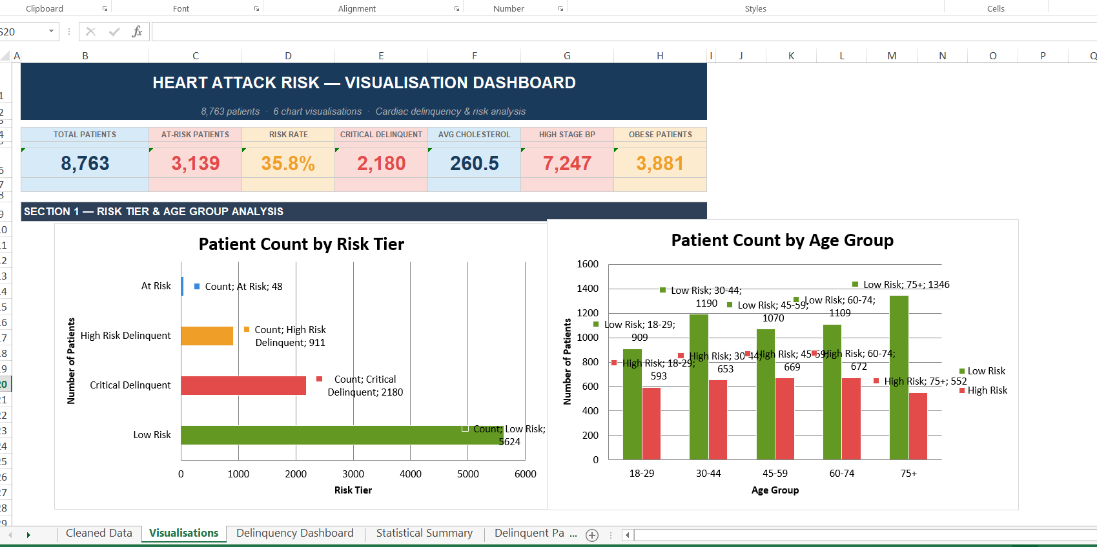
edunet
foundation
Live Demo of Project
Here's the list of some demo screenshots / features of the project:
🖼
🖼
🖼
Demo 1
Demo 2
Demo 3
[Add description of Demo 1 here — what this demo shows, key features, and results achieved.]
[Add description of Demo 2 here — what this demo shows, key features, and results achieved.]
[Add description of Demo 3 here — what this demo shows, key features, and results achieved.]

Slide 8
edunet
foundation
Video of Project Demo
["C:\Users\Hp\Downloads\WhatsApp Video 2026-04-10 at 5.45.46 PM.mp4"]
▶
[Insert your project demo video.
You can embed a video your live project.]

Slide 9
edunet
foundation
Conclusion
✅
[This project successfully demonstrates how hospital patient data can be cleaned and analyzed using Excel and Power BI.
The dashboard provides clear insights into patient flow, treatment outcomes, and hospital performance. It improves reporting accuracy and supports better decision-making..]
• Abstract of the Project
• Problem Statement
• Proposed Solution
• System Architecture
• Live Demo of the Project
• Embedded Video of Project
CONCLUSION
• Conclusion
• Future Scope

Slide 10
edunet
foundation
Future Scope
🧠
[This project successfully demonstrates how hospital patient data can be cleaned and analyzed using Excel and Power BI.
The dashboard provides clear insights into patient flow, treatment outcomes, and hospital performance. It improves reporting accuracy and supports better decision-making..]
• Abstract of the Project
• Problem Statement
• Proposed Solution
• System Architecture
• Live Demo of the Project
• Embedded Video of Project
• Conclusion
[Future ideas & roadmap]
• Future Scope

Slide 11
edunet
foundation
Thank You
AICW Fellowship | Student Project Presentation 2026
LinkedIn | Edunet Foundation

